Slide 1
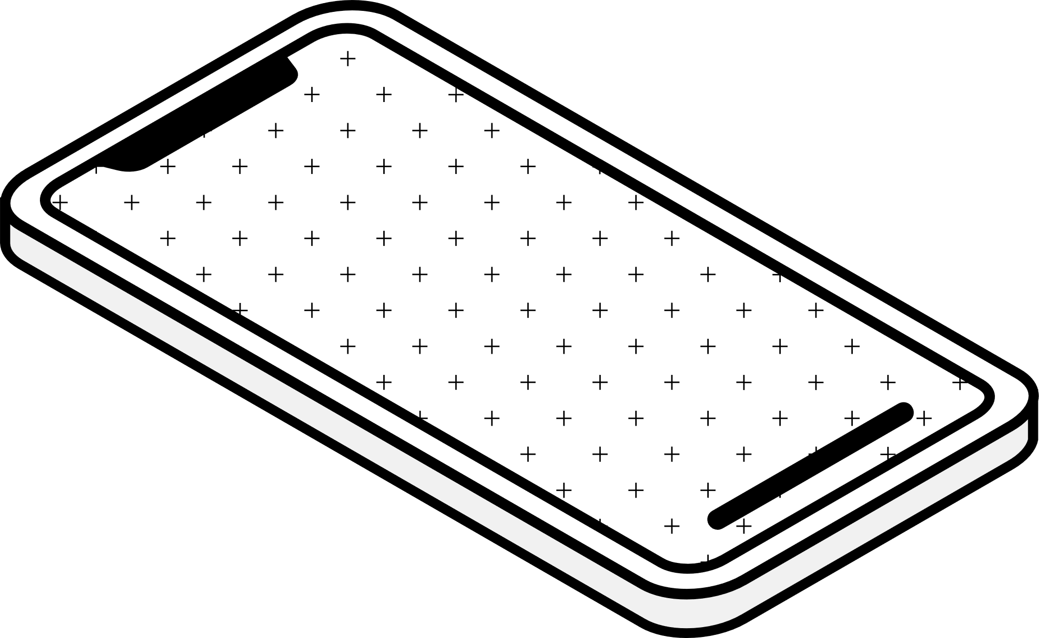
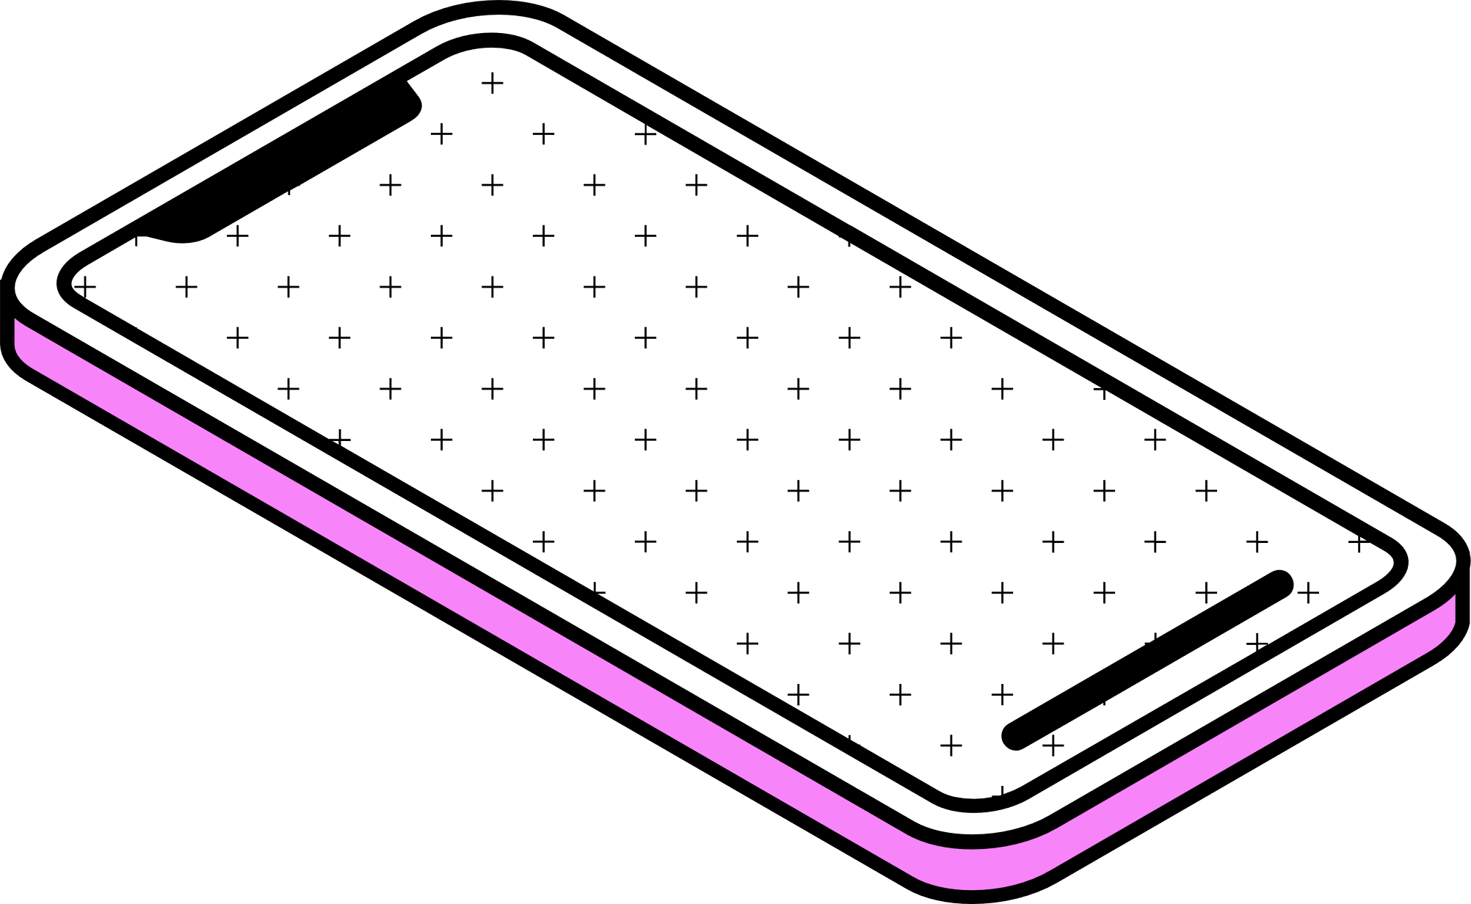
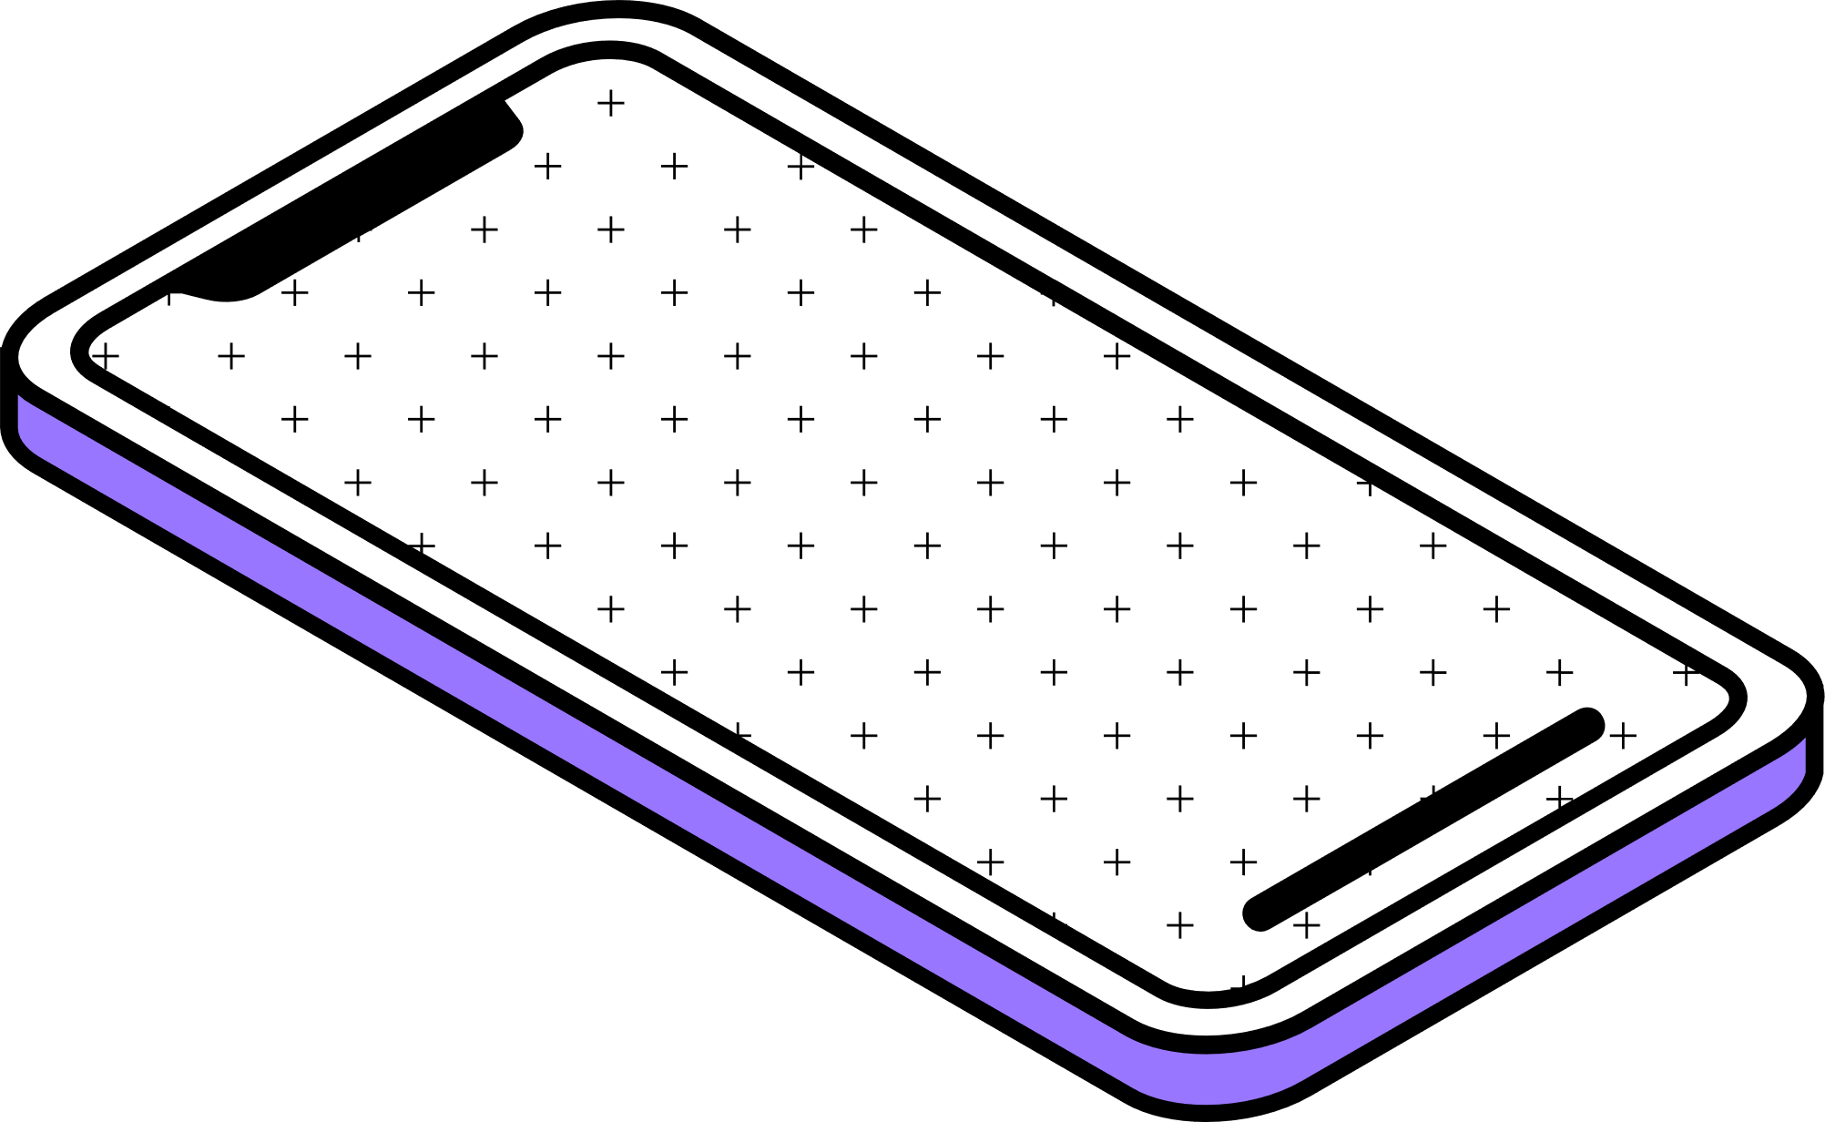
Future Trends in Mobile Application
Name :- Hemanshu Patil
Roll No :- 2211958

Slide 2
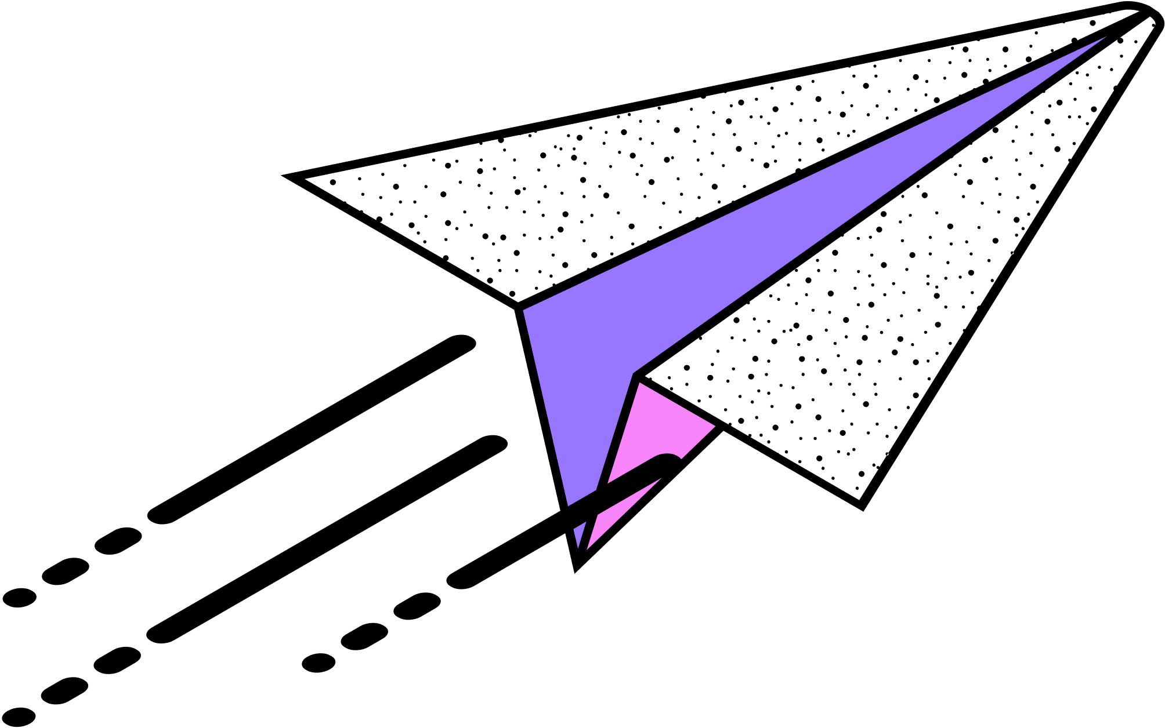
Contents
Introduction to Topic
About to Mobile Application
Evolution of Mobile Apps
Advantages of Mobile Apps
Integrations with other Technologies
Other Features

Slide 3
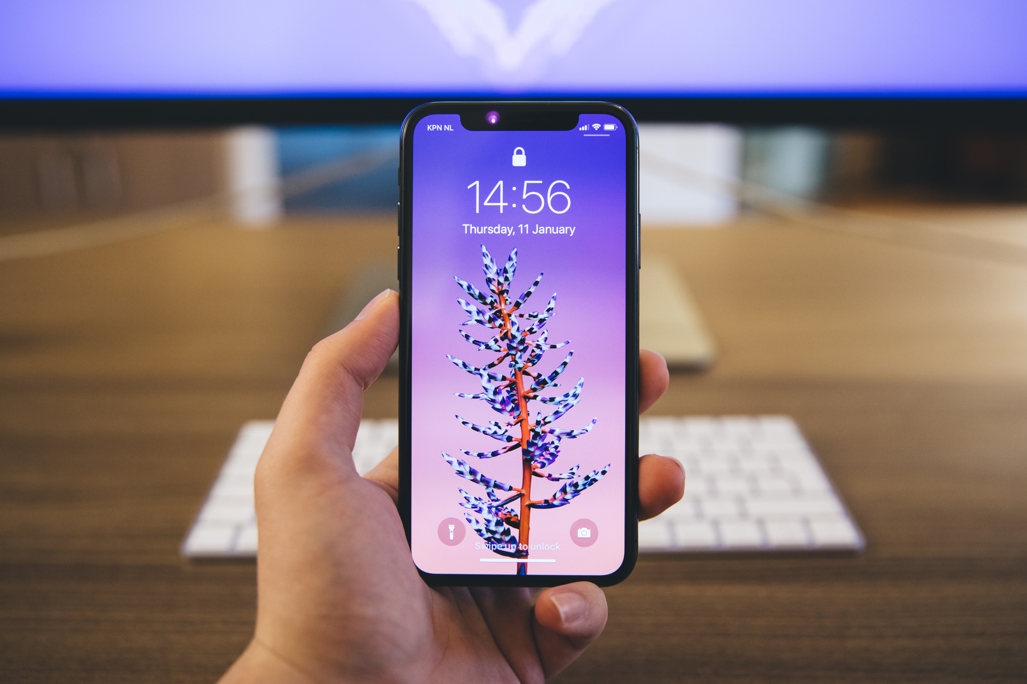
Introduction to Future Trends in Mobile Application
Integration of artificial intelligence for personalization.
Augmented and virtual reality experiences.
Influence of 5G technology for faster connectivity.
Emphasis on cross-platform development.
Focus on security, privacy, health, education in app development.

Slide 4
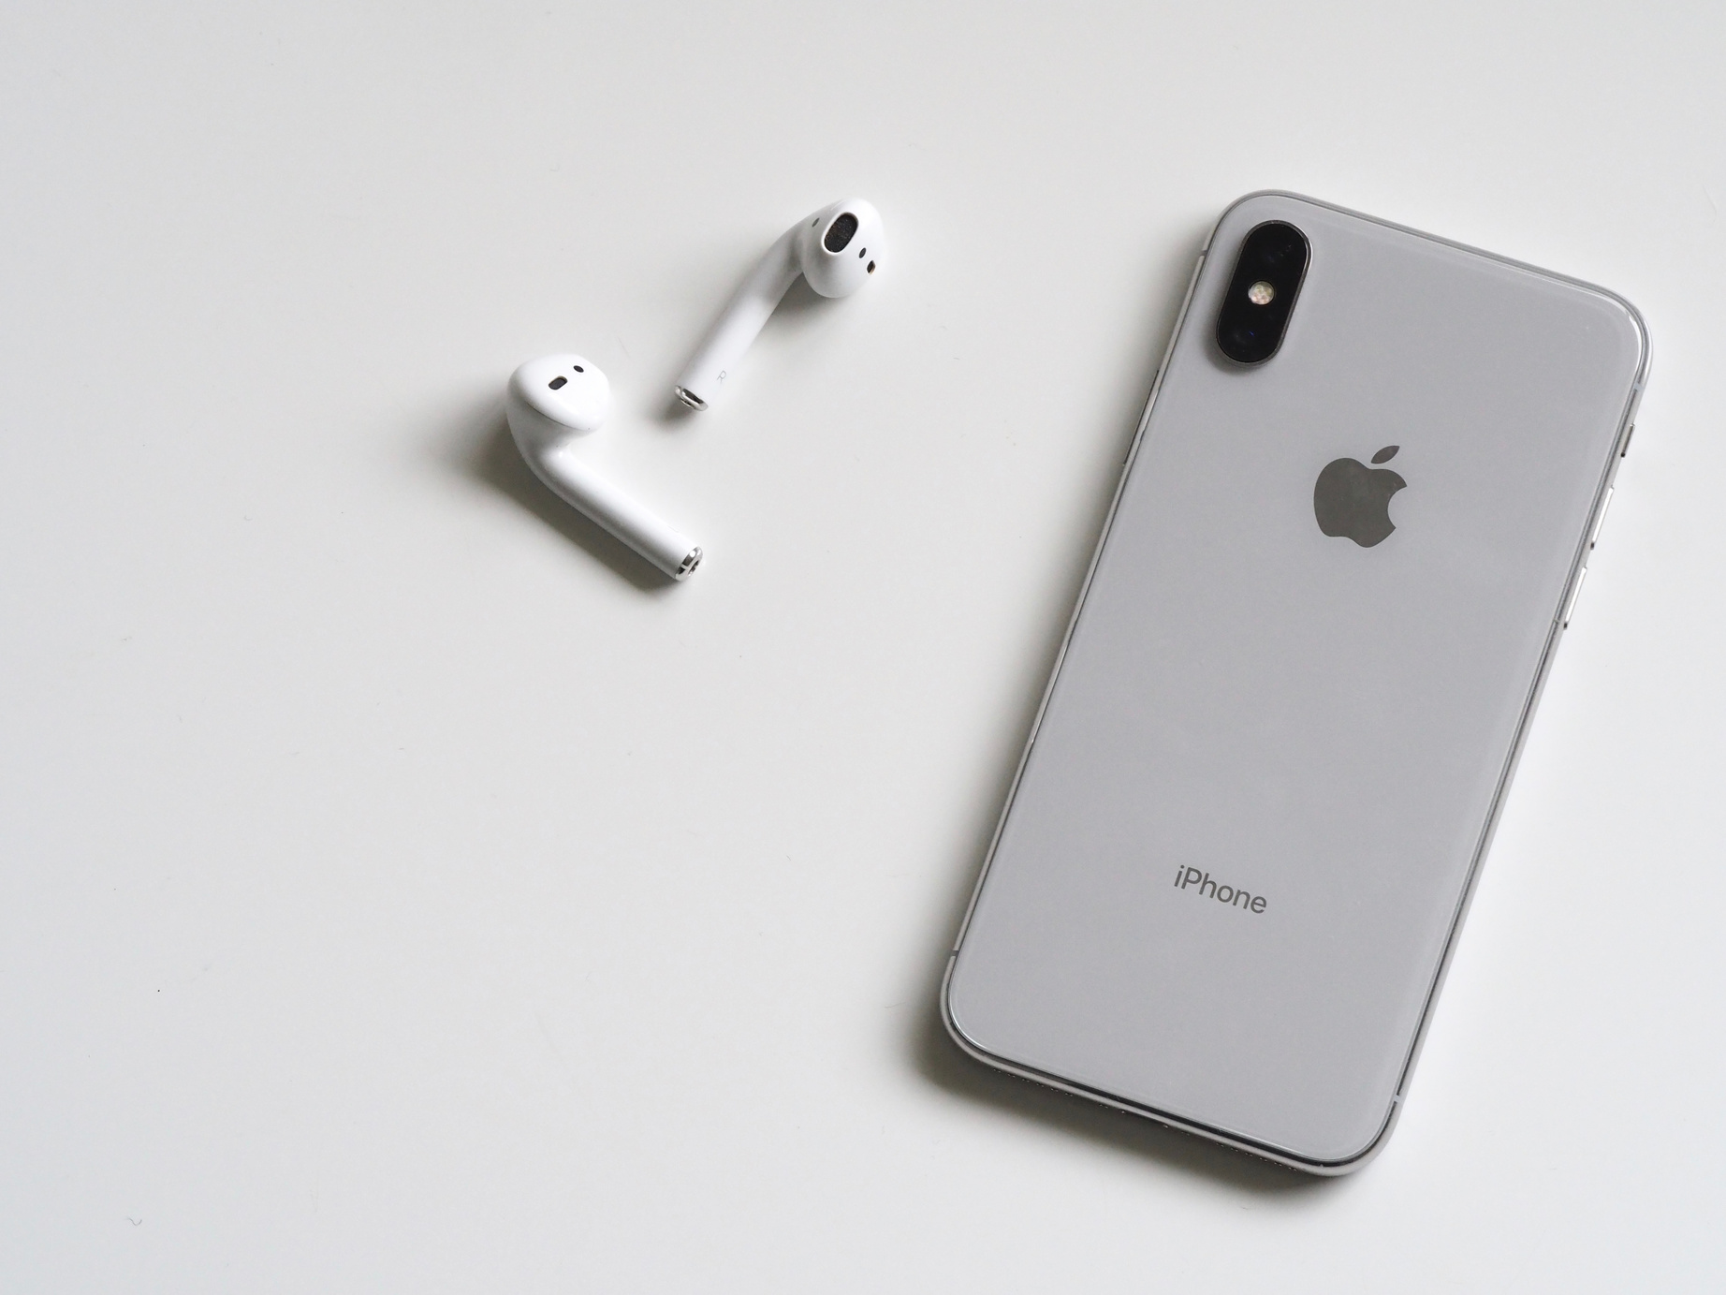
About Mobile Apps
Mobile apps are specialized software for smartphones and tablets.
They offer various services and entertainment options.
Apps are optimized for specific operating systems like iOS and Android.
They ensure a user-friendly and seamless experience.
Mobile apps have become fundamental in daily life.

Slide 5
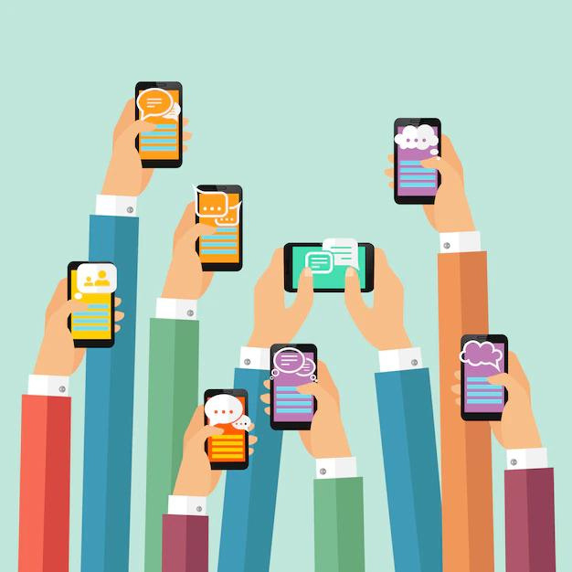
Evolution of Mobile Apps
Started with basic, limited-functionality apps.
Transformed into a multi-billion-dollar industry.
Progressed from simple utilities to AI-driven and AR/VR-enhanced apps.
Redefined work, play, and connection in our lives.
Ongoing evolution promises exciting advancements.

Slide 6
Advantages
Convenience
Personalization
Innovative Features
Social Integration
Security
Cross-Platform Accessibility

Slide 7
Disadvantages
Storage Space
Battery Drain
Data Usage
Device Compatibility
App Development Costs
Distraction and Addiction

Slide 8
Integration with other Technologies
Internet of Things (IoT)
Blockchain
Cloud Computing
Some apps incorporate blockchain technology for secure transactions, such as cryptocurrency wallets and digital identity.
Apps can control and monitor IoT devices in smart homes, from thermostats to security systems.
Cloud computing delivers computing services (e.g., storage, processing) via the internet, reducing the need for local hardware.

Slide 9
Modern Apps Development
Language
Software
Flutter
Java
Kotlin
Vs Code
Android Studio
Xcode

Slide 10
Privacy & Security
Privacy involves respecting users' personal data and only collecting what's necessary with their permission.
Security includes protecting the app and user data from hackers through strong safeguards and regular checks.
These aspects are essential for building trust and ensuring data safety in the digital world.

Slide 11
Encryption &
Decryption
Encryption
This is the process of converting plain or readable data (plaintext) into a coded format (ciphertext) using an encryption algorithm and a secret key.
Decryption
Decryption is the reverse process of encryption. It involves converting the ciphertext back into plaintext using the decryption key.

Slide 12
Conclusion
Mobile apps started with basic functionalities and limited offerings.
Over time, they evolved into a multi-billion-dollar industry with diverse applications.
They began with simple games and utilities, progressing to AI-driven and AR/VR-enhanced apps.
These applications have reshaped how we work, play, and connect.
Ongoing advancements promise even more exciting developments.
Mobile apps are now an integral part of our daily lives and the digital landscape.

Slide 13
References :-
https://www.freepik.com/photos
http://www.pub.dev
https://app.flutterflow.io/dashboard

Slide 14
Thank You

